Slide 1




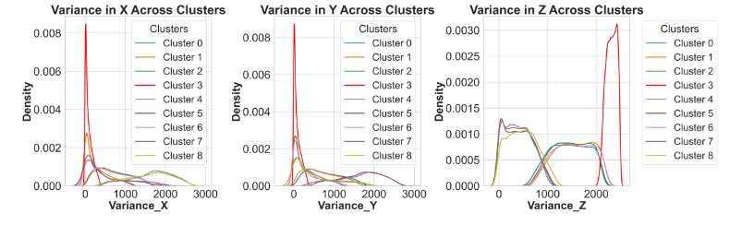
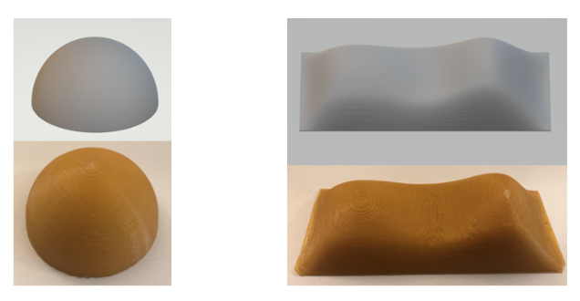


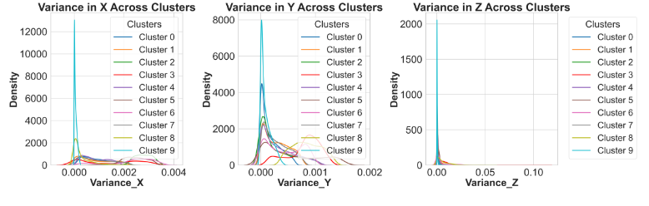

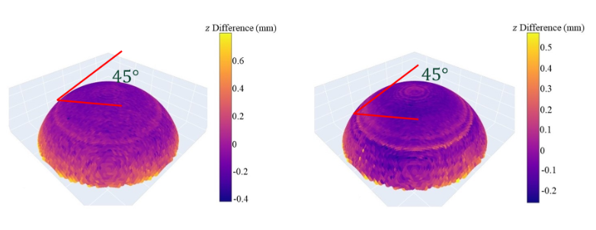

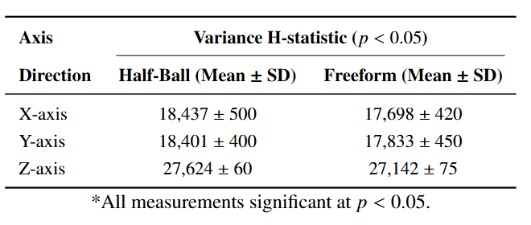
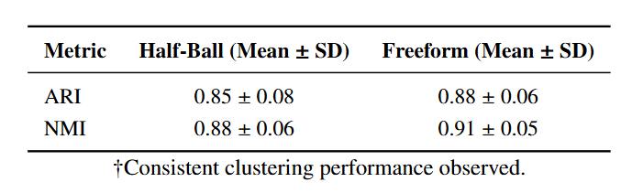
Local PGA pipeline: Develop an unsupervised method to model the local variance and capture the geometric variational patterns.
Unveil the Relationship Between Process and Design Embedded in the 3D Point Cloud using Unsupervised Learning
Evans Nyanney
Department of Industrial and Systems Engineering
Faculty Advisor: Geng Zhaohui
Investigate : Variational patterns in 3D point cloud data related to geometric design and additive manufacturing processes.
Characterize: Key (local) geometric features influencing point cloud accuracy and precision in 3D printed objects.
Figure 1: Average Variance for each cluster (Half-Ball).
Figure 3: Variance Distribution Across Clusters for Half-Ball.
We evaluated scans of two 3D printed objects—a half-ball and a free-form structure—made with a LulzBot TAZ 3D printer using 2.85” polymer filament.
Half-Ball Freeform
Figure 5: The CAD models and physical objects considered in our study.
Link process and design: Reveal the relationship between geometric design and the accuracy and precision of the corresponding additive manufactured parts.
Local PGA pipeline: Develop an unsupervised method to model the local variance and capture the geometric variational patterns.
Figure 2: Average Variance for each cluster (Freeform).
Figure 4: Variance Distribution Across Clusters for Freeform.
Manufacturing signatures: The PGA pipeline segments 3D point clouds into clusters that highlight specific process variations.
Geometry-process mapping: Grouping geometric features links raw structure to manufacturing variations for targeted quality improvements..
Figure 6: Visualization of the pointwise deviations with different layer thick-ness
Data Acquisition & Normalization: Collect 3D scans; standardize or min–max scale coordinates
Spectral Clustering: Build an affinity matrix, compute the Laplacian, then apply eigen-decomposition and k-means.
Label Alignment: Use the Hungarian algorithm to match cluster labels across scans.
Local PGA: Project clusters onto a tangent space; run PCA to extract principal geodesics and map them back.
Variance Validation: Apply Kruskal–Wallis for variance checks; use ARI/NMI to assess clustering stability
Table 1: Variance Analysis for Half-Ball and Freeform Measurements
Table 2: Clustering Consistency Metrics Comparison (Overall, not axis-specific
Robust variance capture: The Local PGA pipeline effectively segments point clouds, revealing localized geometric variability validated by statistical tests and consistent clustering.
Future integration: Future work will link these variations to manufacturing quality and integrate defect detection for enhanced process control.

